Slide 1
Data Science Course - HIT
FBI Crime Data Statistics
Presented By: Yonatan Avizov, Asaf Dangoor

Slide 2
The Project:
The project we have decided to do was to handle the Crime Stats Data given by the United States of America, by a service called the NIBRS.
National Incident-Based Reporting System (NIBRS) is an incident-based reporting system used by law enforcement agencies in the United States for collecting and reporting data on crimes. Local, state and federal agencies generate NIBRS data from their records management systems.
Back in 2014 they have created a suitable Crime Data API that lets you traverse their data.
Notes:
Explain what the project is, what data we took, and from where.
Explain that shit has changed in the middle and that we had to slightly deal with it.
Explain what is NIBRS and all that.

Slide 3
The Project: (Continued)
We took that API and utilized it to our best efforts to answer Data Science related questions. The questions we went with in the end are the following:
Pie Graphs:
How many and what is the rate of crimes for incidents involving people under the age of 18 per their crime location (Airport, nightclub, etc.).
How many and what is the rate of crimes for incidents delegating for different races per their crime location (Airport, nightclub, etc.).
Stacked Bar Graphs:
Rate of crime per region versus the Race involved in the incidents.
Machine Learning: Predicting what gender would the criminal be per the crime reported.
While working on the project we found that some of our initial questions were not applicable, and so after combining the datasets in our project and finding what data we actually have access to we created the questions seen above.
Notes:
Explain what the project is, what data we took, and from where.
Explain that shit has changed in the middle and that we had to slightly deal with it.
Explain what is NIBRS and all that.

Slide 4
The Project: Flow
When we first opened the Crime Stat API we had easier access as developers to the data, though once we sat on the project itself it appears that the NIBRS API has been updated and all you could do was hook up to their Amazon based servers and down giant .zip files containing all the crime per a state and the year.
And so, we have created a dynamic script that lets you place any range of years that the NIBRS has data on, along with the States you wish, and it will download the files (and eventually run the whole project with that data).
Notes:
What we have done to the data itself, and why although seemingly “easy” at first it took so much to accomplish.
Make sure to make them understand that everything here is pretty much 100% dynamic, so any state I want I can get the data from. Along with the years depending if the NIBRS has that data.
Show a sample of a ALL csv

Slide 5
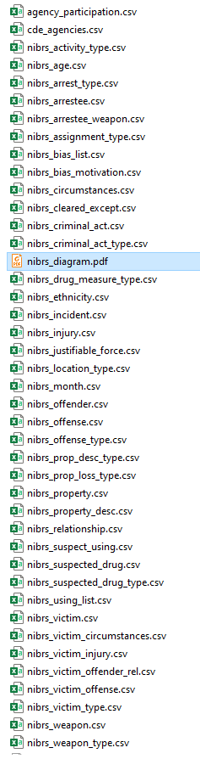
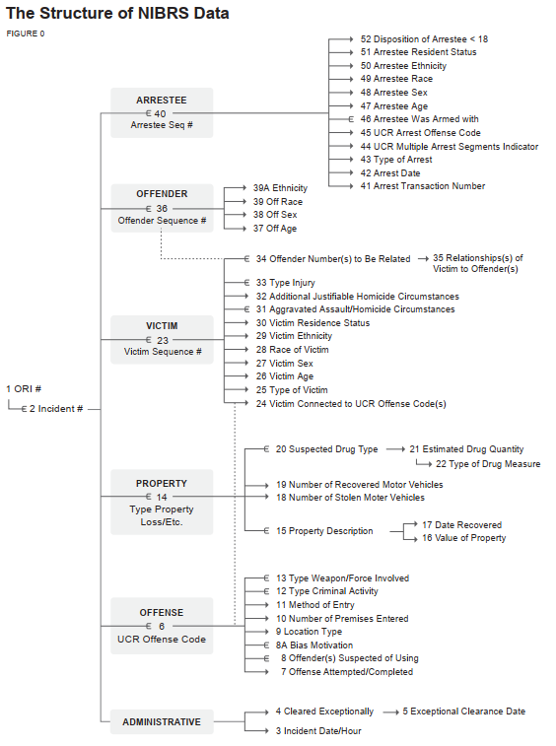
The Project: Data
http://s3-us-gov-west-1.amazonaws.com/cg-d4b776d0-d898-4153-90c8-8336f86bdfec/nibrs_diagram.pdf
The data provided by the NIBRS is .zip with basically lists of CSVs along with other lists of CSVs as “translators” to the coded data.
This is per
State per year.
Notes:
What we have done to the data itself, and why although seemingly “easy” at first it took so much to accomplish.
Make sure to make them understand that everything here is pretty much 100% dynamic, so any state I want I can get the data from. Along with the years depending if the NIBRS has that data.
Show a sample of a ALL csv

Slide 6
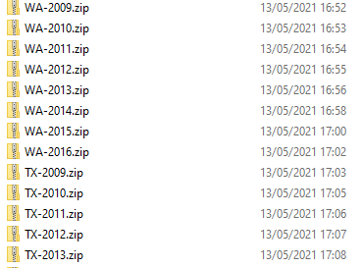
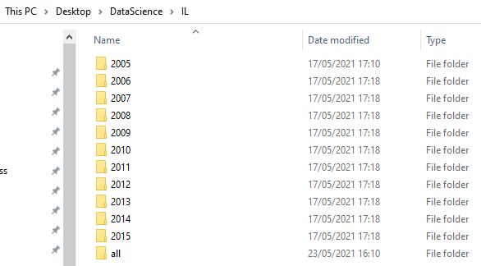
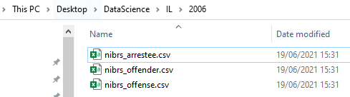
Stage 1: Getting & Unpacking the Data
We first found that we can download the .zip from the website itself - https://crime-data-explorer.fr.cloud.gov/pages/docApi
However that wasn’t sufficient for us, we wanted a dynamic system, so we created a way that took the download links of the amazon-cloud and would iterate over the given values of state and year.
After we downloaded the zips we uncompressed individual files from the long list of csvs given to us by the download, and saved them to neat DIRS.

Slide 7

Stage 2: Processing the Data
The data was far from ready, we removed everything that was not useful, and placed it in a new CSV that combined the 3 we extracted from the .zip and placed it in a “all” folder.
We did this per each state and year.
We then added more layers of information, translating the Coded columns to defined columns we used for graphs later on.
Nibrs_arresstee.csv (Given)
Nibrs_offender.csv (Given)
Nibrs_offence.csv (Given)
IL_2006.csv (Combined and Created)
Notes:
The data was far from ready so we need to clear it up, and make sure it was dynamic.
We had set ups, data structures we used across the board, making sure all the information never went to waste.
We then created the CSVs we need per each year per each State we wanted, and in theory if we wanted we could just swap to another array of states and the code would comply to it.

Slide 8

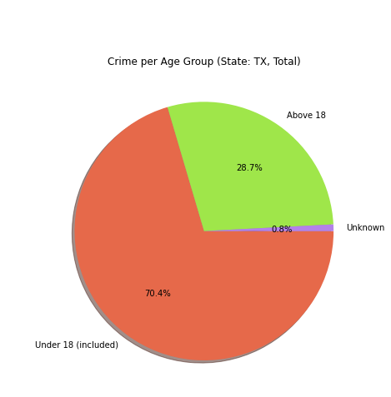
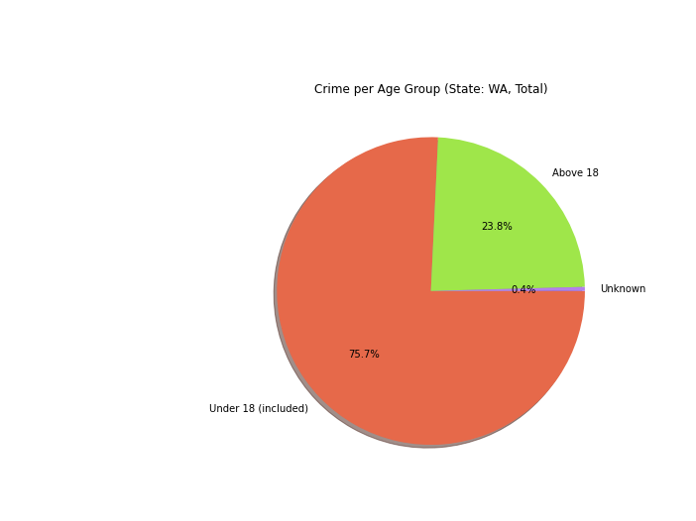
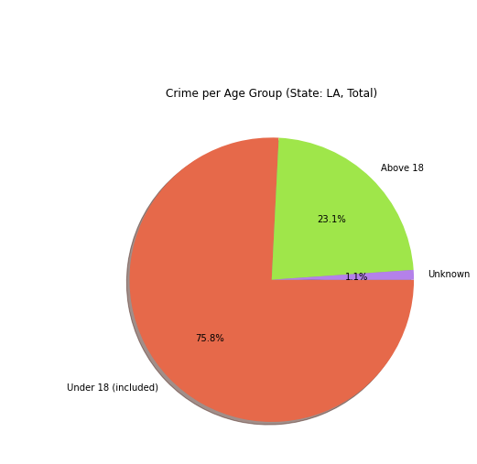
Results Q1.1: Teenagers (age 18 or below) per their crime location
LA average TX average WA average
2005-2015 2005-2015 2005-2013

Slide 9
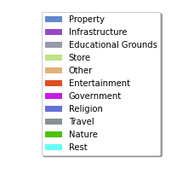
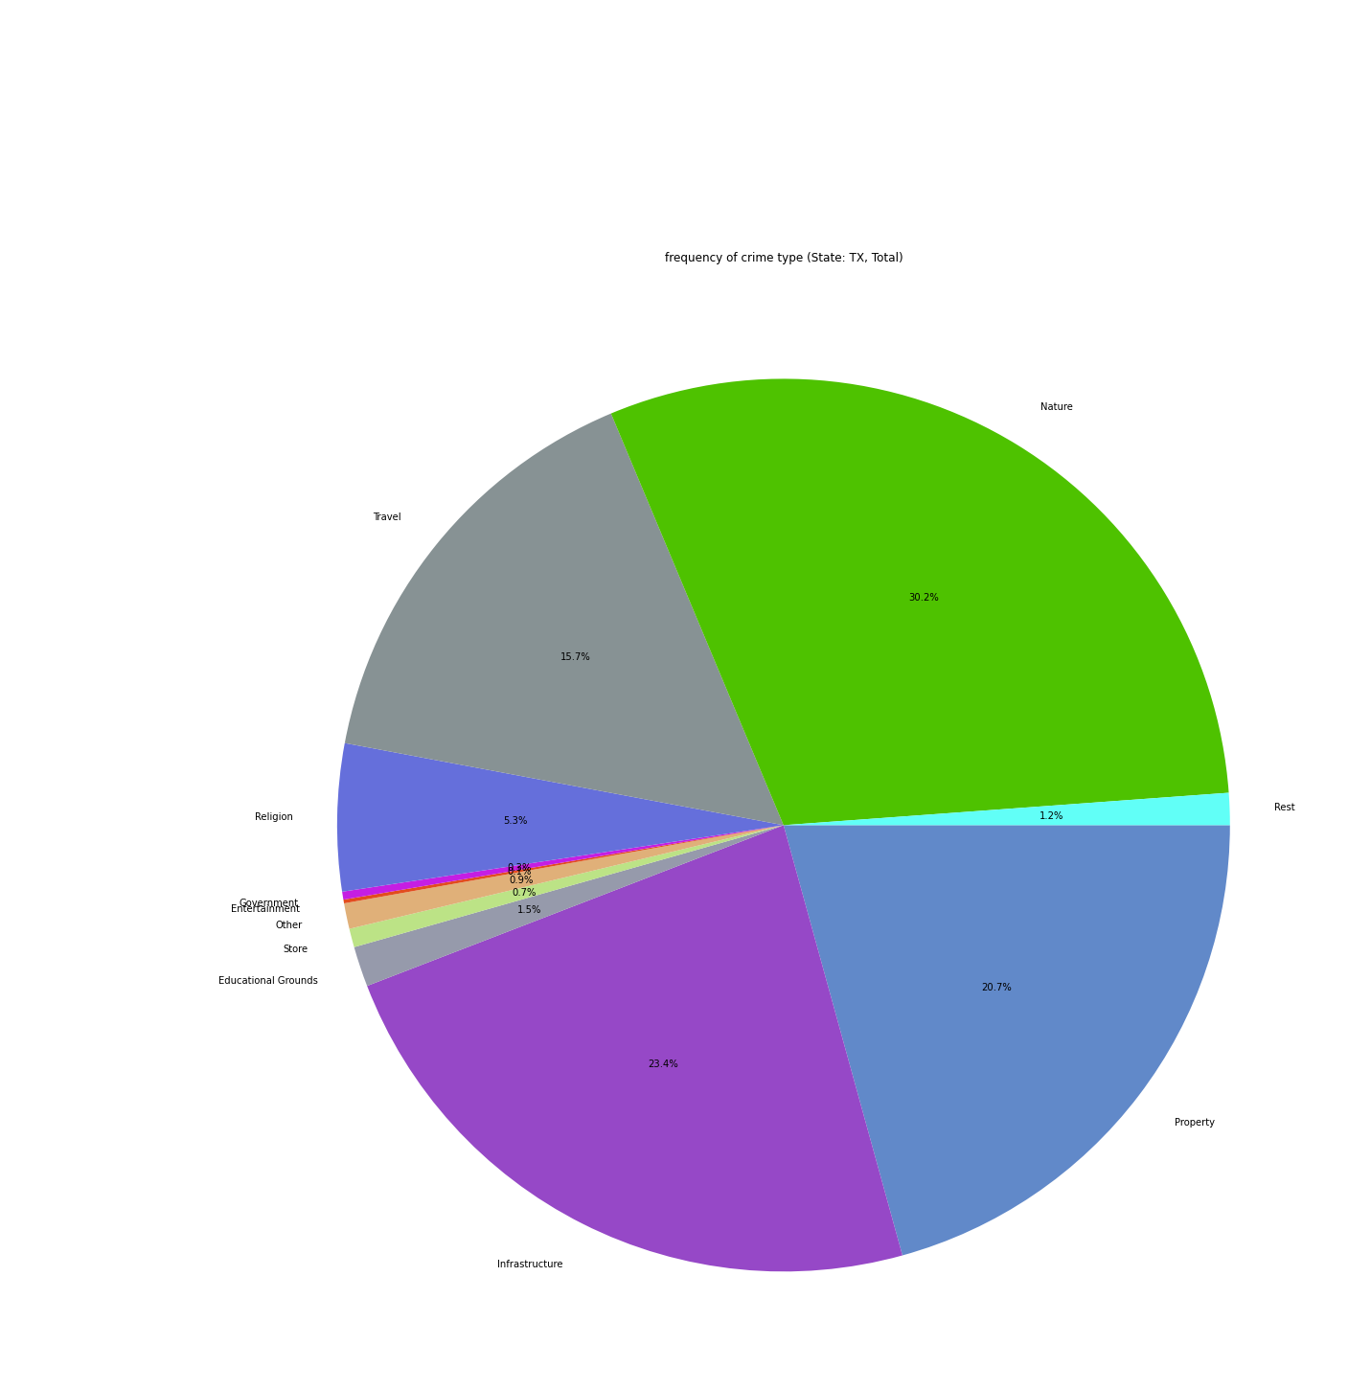
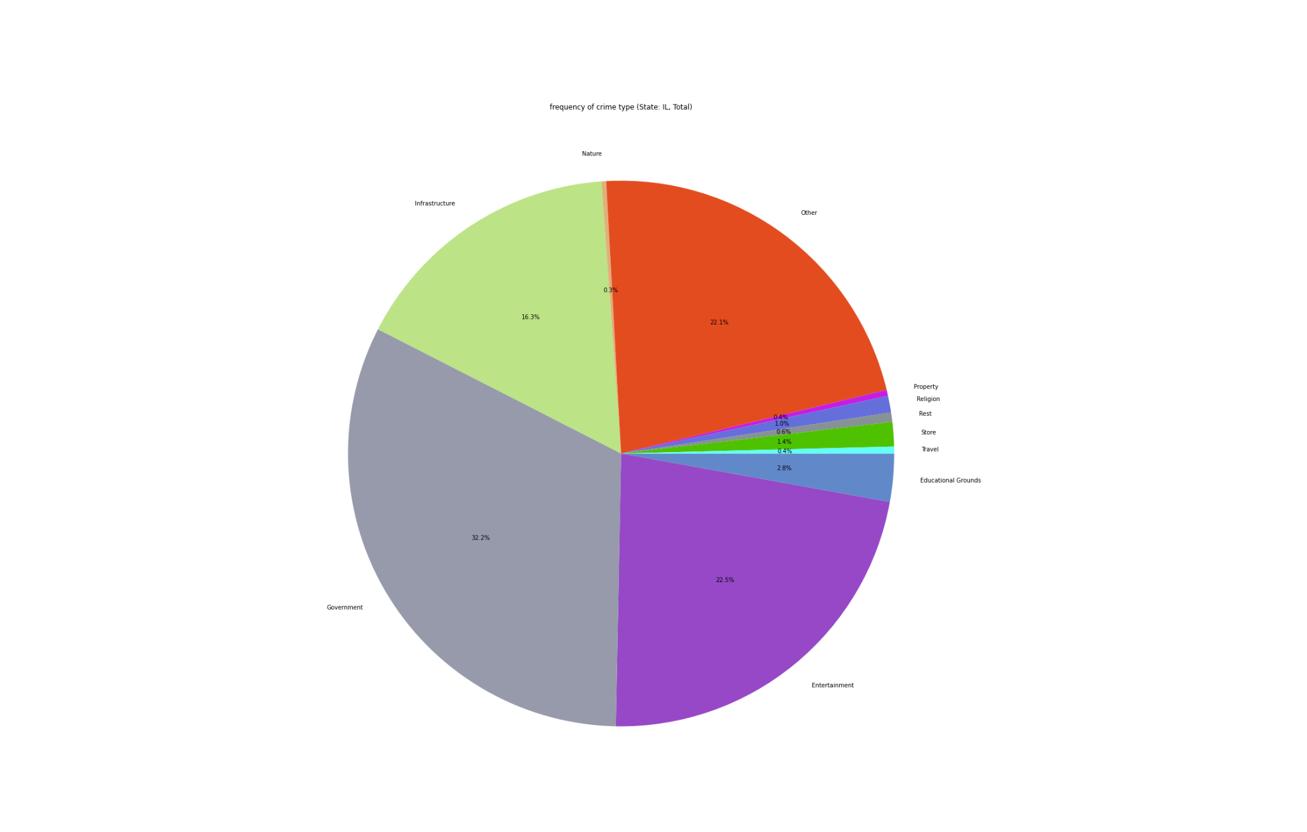
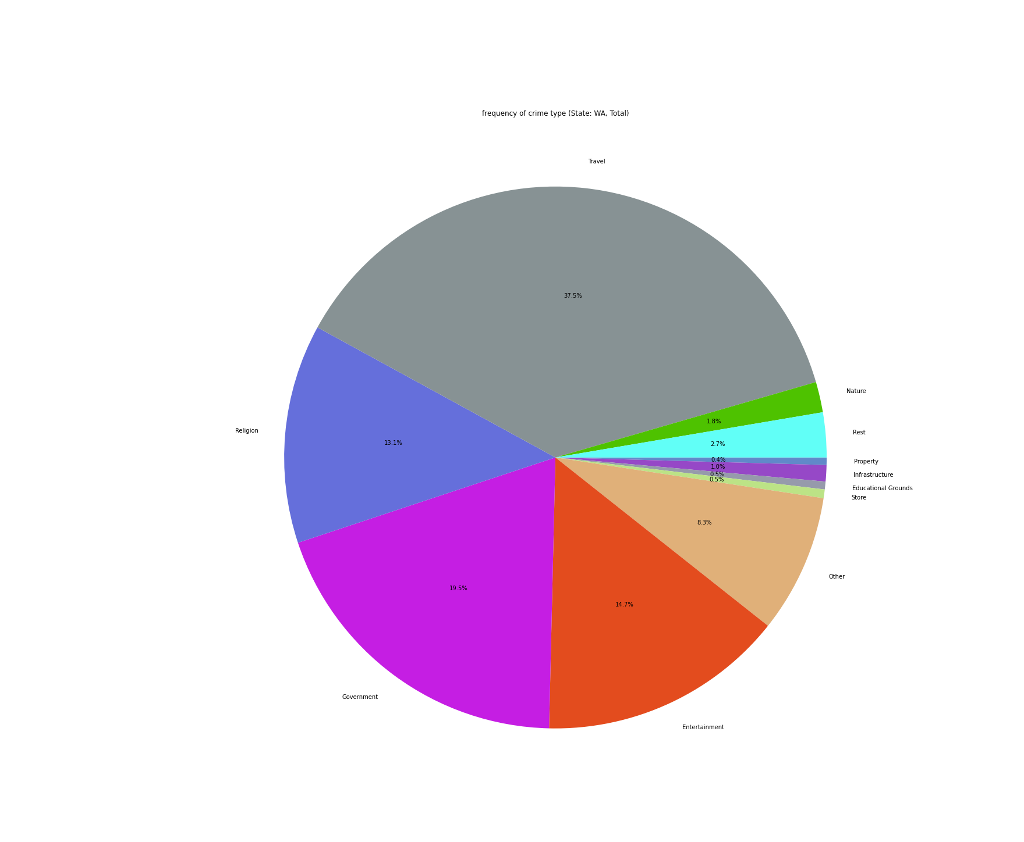
Results Q1.2 : Rate of crimes per the Region
LA_freq WA _freq IL_freq TX_freq
2005-2015 2005-2015 2006-2016 2005-2015

Slide 10
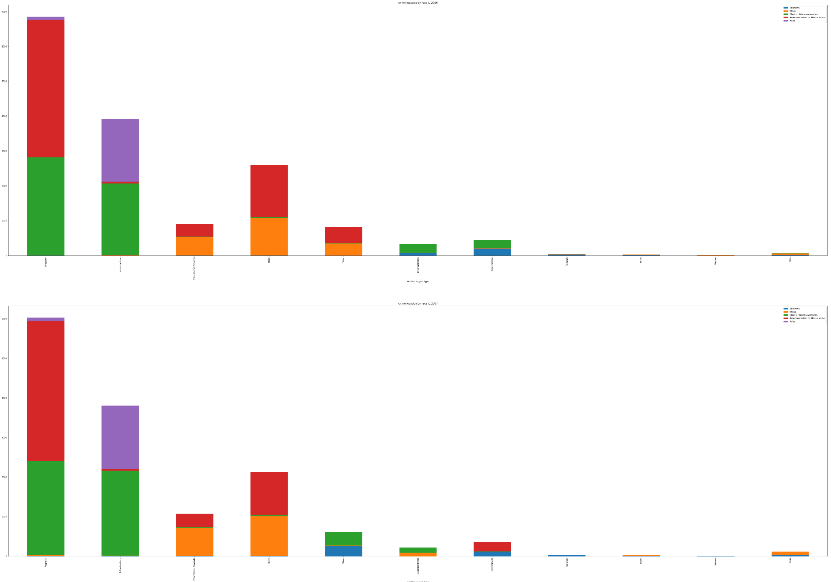
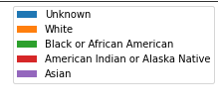
Results Q2: The rate of crime per Region per Race
The following is the example of TX in years 2005-2006.
For more examples see the attached images.
Notes:
Rate of crime per Region // Race

Slide 11
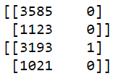
Results [ML]: Gender crime prediction
We tried to make a Logistic Regression ML that given the data from each state and year, would then try (with its given model) to predict if the crime was done by a Male or a Female.
We adjusted the data prior to running this for each state, but at the end we reached that our model is ineffective.
Most likely the reason is that there is no real correlation between what gender does the crime itself.

Slide 12
Summery
In general we learned a lot from this project, we had multiple issues at each step of the way but we managed to solve each of them on our own.
If we had more time we’d investigate more about the type of data and create a better ML and other niche things as said by this Crime Data Analyst: https://jacobdkaplan.com/data.html
Links we used:
https://www.fbi.gov/file-repository/ucr/ucr-2019-1-nibrs-user-manua-093020.pdf/view
https://crime-data-explorer.fr.cloud.gov/pages/home
https://www.icpsr.umich.edu/web/pages/NACJD/NIBRS/varlist.html
https://github.com/fbi-cde/crime-data-frontend
https://www.fbi.gov/file-repository/ucr/ucr-2019-1-nibrs-user-manua-093020.pdf/view

